Slide 1
SQL Server Database Management

Slide 2
Objectives(1)
Explain the features of SQL Server
Describe the enterprise-level functions, characteristics and advantages of SQL Server
Describe SQL Server services
Work with Enterprise Manager, Query Analyzer
Explain the use of database file and log file

Slide 3
Objectives(2)
Explain the differences between physical storage in SQL Server and Access
Explain how to create and delete databases in SQL Server
Explain maintenance operations

Slide 4
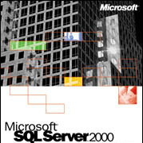
Introduction to SQL Server 2000
SQL Server 2000
comprises of a number of
features, which makes it a
relational database
management system that
offers very high degree of
performance.

Slide 5
Editions of SQL Server 2000
SQL Server 2000 comes in various editions like:
  SQL Server 2000 Enterprise Edition
  SQL Server 2000 Standard Edition
  SQL Server 2000 Personal Edition
  SQL Server 2000 Developer Edition
  SQL Server 2000 Desktop Engine
  SQL Server 2000 Windows CE Edition

Slide 6



SQL Server 2000 features (1)
Easy Installation
Integration with Internet
WinNT
+
Win2k
Supports Client/Server model
Operating System Compatibility

Slide 7
SQL Server 2000 features (2)
* Multiple-Protocol compatibility
* Data Warehousing
* ANSI/ISO SQL-92 Compliant
* Data Replication support
* Full-Text search
* Books Online

Slide 8
Installing SQL Server -1
Hardware Requirements
Processor Intel compatible 32-bit CPU
Disk space For a minimum install 95 MB, for full install 270 MB
NICard Necessary if clients are connected to the server
RAM 128 MB
CD-ROM Necessary for CD installation

Slide 9



Installing SQL Server -2
Software Requirements
Windows 98, Windows NT Server 4.0 with Service Pack 5 or later, Windows NT Workstation 4.0 with Service Pack 5 or later or Windows 2000 (all editions).
Internet Explorer 5.0 or later

Slide 10
SQL Server Enterprise Manager
Primary administrative tool for SQL Server 2000
Provides an interface that allows users to
    define groups of servers running SQL Server
    register individual servers in a group
    configure all SQL Server options for each registered server
    create and administer all SQL Server databases, objects, logins, users, and permissions in each registered server.
Can be launched by selecting the Enterprise Manager icon in the Microsoft SQL Server program group.

Slide 11
Logging in to SQL Server-1
We can log in to an instance of SQL Server by using any of the graphical administration tools or from a command prompt.
When we log in to an instance of SQL Server we are prompted to supply the server name, a login ID, and a password, if necessary.

Slide 12
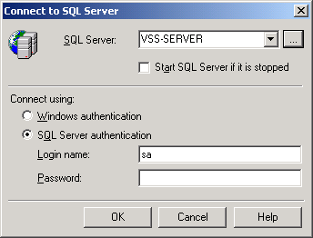
Logging in to SQL Server-2

Slide 13
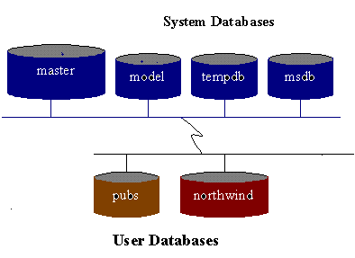
SQL Server Databases
SQL Server has two types of databases:
- System Databases
- User Databases

Slide 14
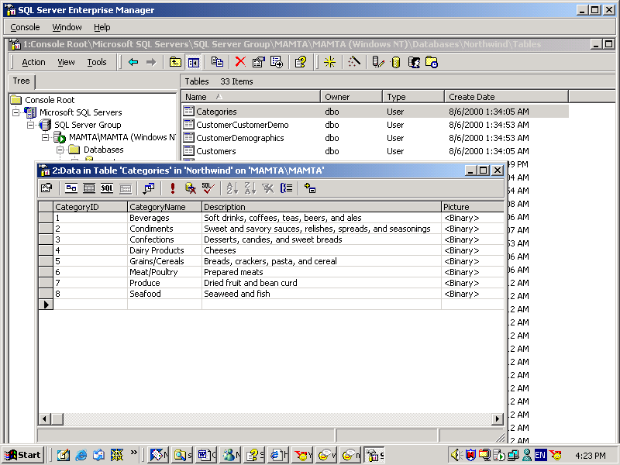
Sample predefined database in SQL Server: NorthWind

Slide 15
Transact SQL
Set of programming extensions from Microsoft.
Adds several features to SQL including transaction control, exception error handling and row processing.
Allows to declare and utilize local variables and constants within a Transact-SQL object.

Slide 16
SQL Server Query Analyzer-1
SQL Server 2000 offers two tools to work with:
    Enterprise Manager
    Query Analyzer
The Query Analyzer is a graphical user interface using which developers and administrators can perform everyday tasks such as querying tables, manipulating data within the tables very easily.
SQL Server Query Analyzer can be launched by selecting the Query Analyzer icon in the Microsoft SQL Server program group.

Slide 17
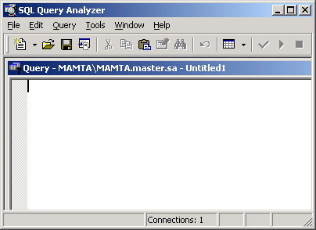
SQL Server Query Analyzer-2

Slide 18
Books Online
Books Online is the online help facility of SQL
Server and provides extensive material on topics
right from installing SQL Server to assistance on
creating and managing databases, using the
Enterprise Manager and Query Analyzer.

Slide 19

Database files and log files
SQL Server databases have three types
of files:
Primary data files
Secondary data files
Log files

Slide 20
Creating databases in SQL Server
We follow the below steps to create a
database using Enterprise Manager:
  Launch the Enterprise Manager and
  select Databases.
  Select the Action menu on the menu bar
  and select the New Database option from
  the dropdown menu

Slide 21
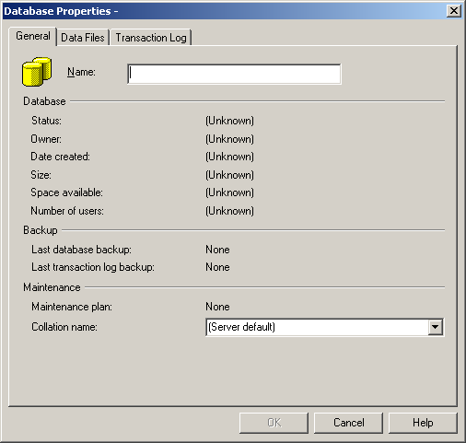
Naming the new database

Slide 22
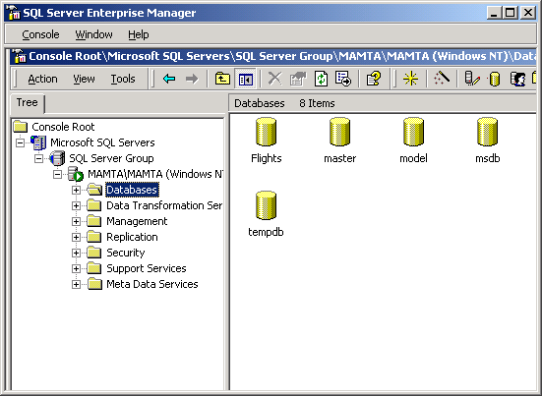
Enterprise Manager window

Slide 23
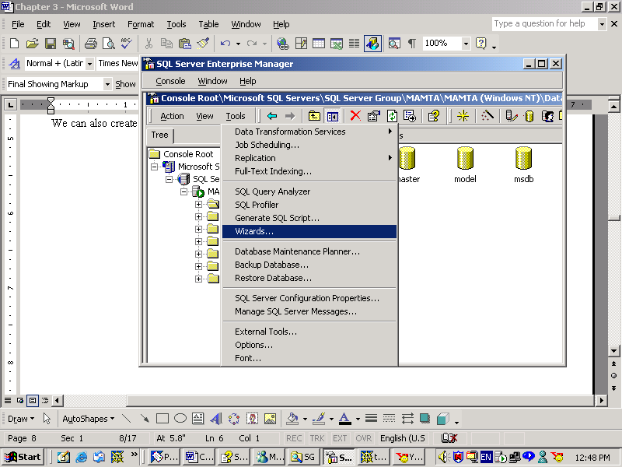
Creating databases using Wizards-1

Slide 24
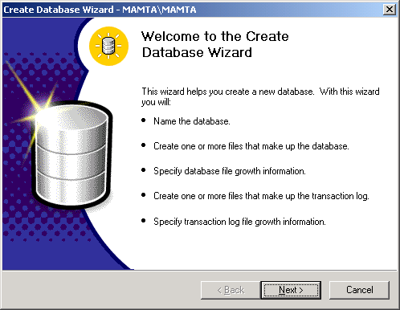
Creating databases using Wizards-2

Slide 25
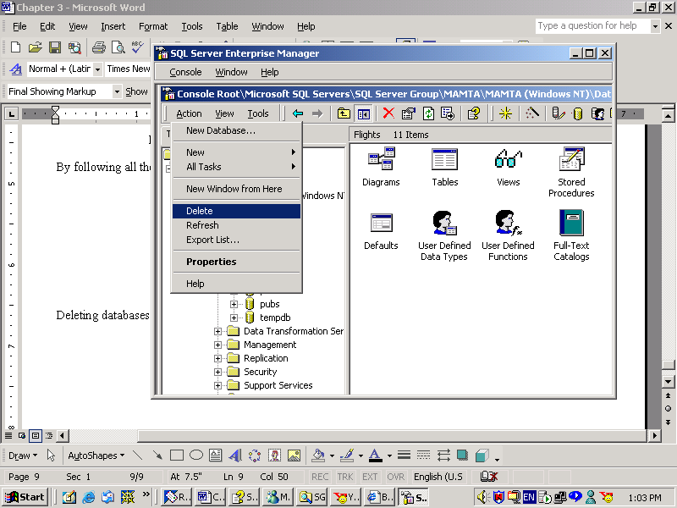
Deleting databases using Enterprise Manager

Slide 26
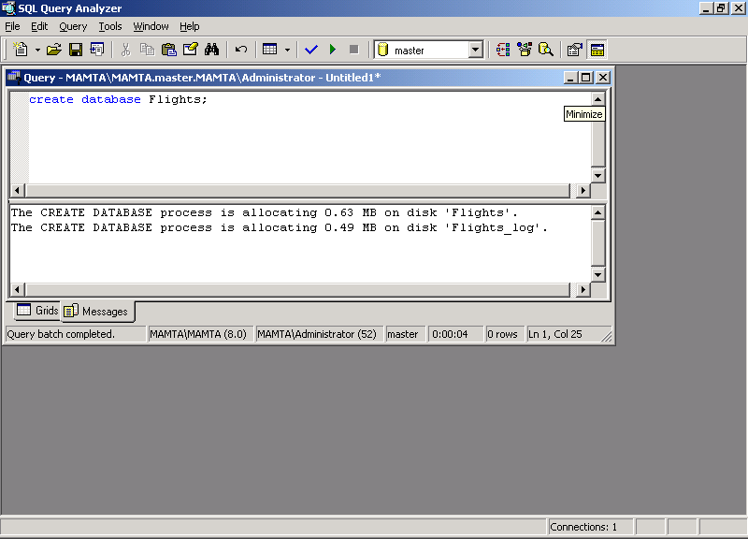
Creating Database using T-SQL
The T-SQL command to create a database is:
CREATE DATABASE

Slide 27
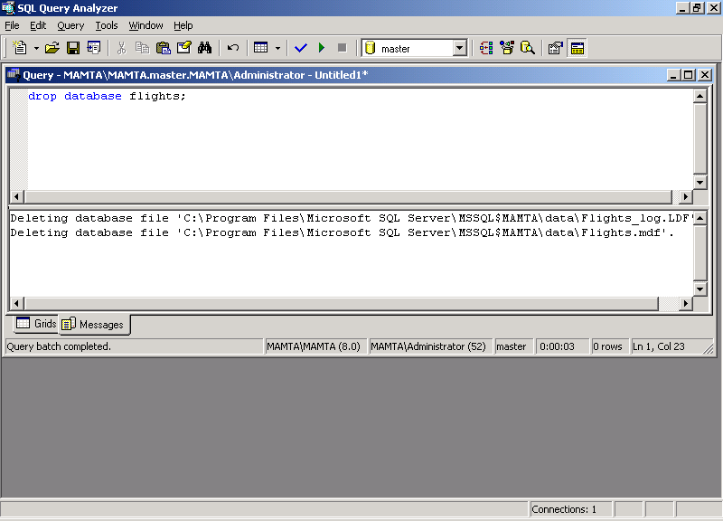
Deleting databases using T SQL
The DROP DATABASE command removes one or
more databases from Microsoft SQL Server

Slide 28
Configuring SQL Server databases
EXEC sp_dboption ‘pubs’, ‘read only’, ‘True’
This option sets the database ‘pubs’ to read-only.
EXEC sp_dboption ‘pubs’ autoshrink true
This option will set the ‘pubs’ database file eligible
for automatic periodic shrinking.
EXEC sp_dboption ‘pubs’ single user
This command allows only one user to access the
database at a time.

Slide 29
Shrinking databases
The DBCC command can be used to shrink
the size of data files in the database.
For example,
DBCC SHRINKDATABASE(PUBS, 10)
Will decrease the size of files in ‘Pubs’ database to
allow 10 percent.

Slide 30
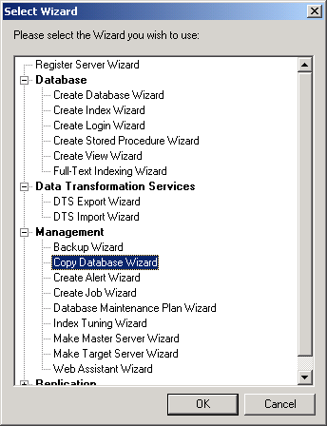
Selecting the Copy Database Wizard

Slide 31
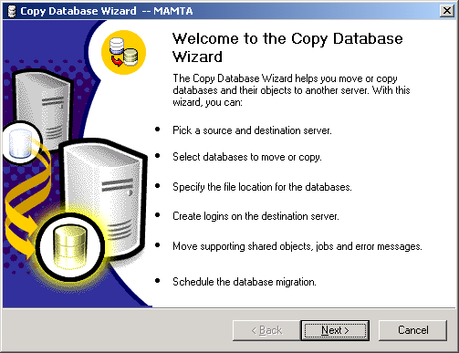
Copy Database Wizard

